Slide 1

www.espirity.com
Using Ant in Eclipse
Dwight Deugo (dwight@espirity.com)
Nesa Matic (nesa@espirity.com)
Notes:
Portions of the notes for this lecture include excerpts from the Eclipse 3.0 Help facility. These excerpts are made available under CPL for ease of use by instructors, (c) Copyright (c) 2000, 2004 IBM Corporation and others. For more complete information instructors are encouraged to read the full notes from the Eclipse Help facility.

Slide 2
Additional Contributors
None as of September, 2004

Slide 3
Module Overview
What is Ant?
Ant Build File
Running Ant

Slide 4
Module Road Map
What is Ant?
  Goals
  Motivation
  Terminology
Build File
Running Ant

Slide 5
What is Ant?
Ant is an open source project
  http://ant.apache.org/
  Java-based build tool
  Used on any Java 1.1+ system
  Command line driven
  Integrated with IDEs
  Uses XML files to describe the build process

Slide 6
Ant’s Design Goals
Simple to use
Easy to understand
Can be extended

Slide 7
Ant Motivation
Build, test and deploy Java Projects
Workflow engine
Web publishing engine
Support .Net and other languages
Automation

Slide 8
Projects and Properties
Project
  Defines one or more targets and any number of properties
<project name=“test” default=“compile” basedir=“.”>
Property
  A property has a name and a value
    <property name=“build” value=“bin\”/>
  Ant has built-in properties
Notes:
A project has many properties that can been seen in the appendix.
There are many Ant built-in properties available for users, as shown in the appendix.

Slide 9
Targets and Tasks
Target
  Defines a sequence or block of tasks to execute
  <target name=“first” >
    <echo message=“I am the first target”/>
    </target>
Task defines the actual commands that Ant executes
  Core Tasks: tasks shipped with Ant
  Optional Tasks: a task from a third party that require an additional JAR
  User-Defined Tasks: tasks developed by the user
Notes:
A Target has many properties that can been seen in the appendix.

Slide 10
PatternSet Datatype
Filter files or directories using a pattern
  * match >= 0 characters
  ** match >= 0 directories recursively
  ? match 1 character
Get all java files except those with broken in the name
<patternset id=“javafiles”>
  <include name=“**/*.java”/>
  <exclude name=“**/*broken*.java”/>
</patternset>

Slide 11
Fileset Datatype
Groups files based on patterns
Different forms
  Using attributes
  Using nested patternset
  Using patternset elements
<fileset dir=“src”>
  <include name=“**/*.java”/>
  <exclude name=“**/*broken*.java”/>
</fileset>

Slide 12
Other Datatypes
Description – project description
DirSet – directory set
FileMapper – filename translation
FileReader – call to filter out files
FilterChain – series of FilterReaders
Filterset – filter groups
..

Slide 13
Module Road Map
What is Ant
Ant Build File
  Conceptual build file
  Real build file
  Properties
Running Ant

Slide 14
Conceptual Project Build File
YourProject: Project
initialize: Target
<mkdir>: Task
<mkdir>: Task
compile: Target
document: Target
<javac>: Task
<javadoc>: Task
deploy: Target
<jar>: Task
<ftp>: Task
Notes:
This picture is a conceptual view of a build file. The project consists of a number of targets. Inside each target are a number of task declarations. Tasks are actions that Ant must invoke to build the target. Targets can state dependencies on other targets, producing the above graph. When you execute a target, all of its dependencies must execute first.

Slide 15
Real Build File…
<?xml version="1.0" ?>
<project name="MYPROJECT" default="compile" >
<target name="init">
<mkdir dir="build/classes" />
<mkdir dir="bin" />
</target>
<target name="compile" depends="init">
<javac srcdir="src" destdir="build/classes" />
</target>
<target name="archive" depends="compile">
<jar destfile="bin/myproject.jar"
basedir="build/classes" />
</target>

Slide 16
…Real Build File
<target name="execute" depends="compile">
<java
classname="FirstClass"
classpath="build/classes">
<arg value="first argument passed"/>
<arg value="second argument passed"/>
</java>
</target>
<target name="clean" depends="init">
<delete dir="build" />
<delete dir="bin" />
</target>
</project>

Slide 17
Important Tags: <project>
Attributes
  default: the default target to run
  name: the name of the project
  basedir: the base directory of the project
  description: a description of the project
<project name=“MYPROJECT" default="compile" basedir=". "
description="This is a demo project">
Notes:
Ant uses XML files called build files to describe how to build an application. Testing and deployment can also be part of the build process.
Developers describe the build using high-level declarative statements. This keeps the build files small and easy to read.
Every build file is associated with one project. However, large projects can be made to be composed of multiple smaller projects, each with its own build file.
You can declare multiple targets in a build file. Each target can be used to represent different outputs of the build, and each target can be dependent on other targerts.
Tasks represent the actual work to be done inside of a target.

Slide 18
Important Tags: <target>
Container tag for tasks
Attributes
  name: the name of the target
  depends: dependent targets
  if: execute only if property is set
  unless: execute only if property is not set
  description: description of the target
<target name="compile" depends="init"
description="Compile everything">

Slide 19
Important Tags: <buildnumber>
The tag reads the build number from a file and sets the property build.number
Attributes
  file: the name of the file with the build number
<buildnumber file="buildnumberfile.txt"/>

Slide 20
Important Tags: <copy>
Copy a file or set of files
Attributes
  file: source file
  tofile: target file
  todir: target directory
  overwrite: boolean to overwrite destination files (f)
  includeEmptyDirs: boolean to copy empty directories(t)
  failonerror: stop if file not found (t)
  verbose: list files copied (f)
<copy file="myfile.java" todir="src"/>

Slide 21
Important Tags: <delete>
Delete a file or set of files
Attributes
  file: file to delete
  dir: directory to delete
  includeEmptyDirs: delete empty directories(t)
  failonerror: stop on error (t)
  verbose: list files deleted (f)
<delete file="myfile.java" />

Slide 22
Important Tags: <mkdir>
Create a directory
Attributes
  dir: the name of the directory to create
<mkdir dir="dist/bin"/>

Slide 23
Important Tags: <echo>
Write a message to System.out
Attributes
  message: text to write
  file: output file
  append: append rather than overwrite a file
<echo message=“Time to go" />
<echo> Time to go </echo>

Slide 24
Important Tags: <jar>
Make a jar file
Attributes
  destfile: the JAR file name
  basedir: directory of files to be JARed
  includes: pattern of files to be JARed
  excludes: patterns of files to be excluded
<jar destfile="dest/working.jar">
<include name="**/*.class"/>
<exclude name="**/*broken*"/>
</jar>

Slide 25
Important Tags: <java>
Execute a java class
Attributes
  classname: the name of class to run
  jar: name of JAR containing the class
  classpath: classpath to use
  fork: run the class in a new VM
  failonerror: stop if error occurs
  output: output file
  append: append or overwrite default file
<java classname=“mydemo"/>

Slide 26
Important Tags: <javac>
Compile a java file or set of files
Attributes
  srcdir: base of source tree
  destdir: output directory
  includes: pattern of files to compile
  excludes: pattern of files to exclude
  classpath: classpath to use
  debug: include debug information
  optimize: use optimization
  verbose: provide verbose output
  failonerror: stop on error
<javac srcdir="src" destdir="bin"/>

Slide 27
Important Tags: <property>…
Name-value pair
Predefined properties
  java.class.pat
  os.name
  os.version
  user.name
  user.home
  ant.version
  ant.file
  ant.project.name

Slide 28
…Important Tags: <property>…
Attributes
  name: name of property
  value: value of property
Use properties as follows
#setting
<property name="report_location “ value="C:/reportdir "/>
<delete dir="${report_location}"/>

Slide 29
…Important Tags: <property>
Property file
  Create a file build.properties
  Use standard Java properties file format
  Read property file as follows
# build.properties
report_name=report.txt
report_location=C:/reportdir
<property file="build.properties"/>

Slide 30
Module Road Map
What is Ant?
Ant Build File
Running Ant
  Running the build file
  Modifying the classpath
  Adding new tasks and types
  Using a different version of Ant

Slide 31
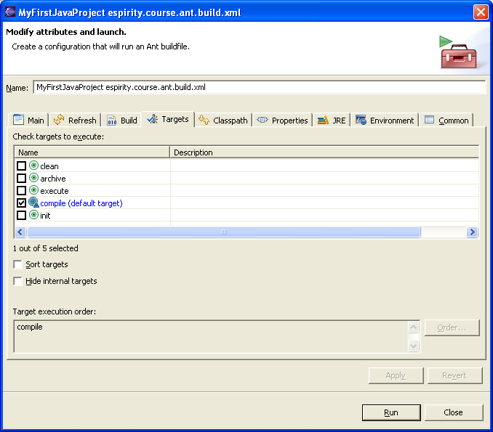
Running an Ant Build File
In the Navigator view, select an XML file
From the file's pop-up menu, select Run Ant

Slide 32
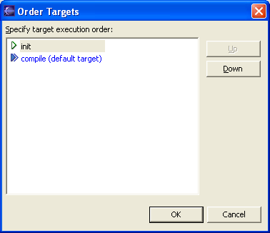
Select Targets
Select one or more targets from the Targets tab
  Targets are run in order of selection
  Order displayed in the Target execution order box at the bottom of the tab
  Change the order of the targets by clicking the Order... button

Slide 33
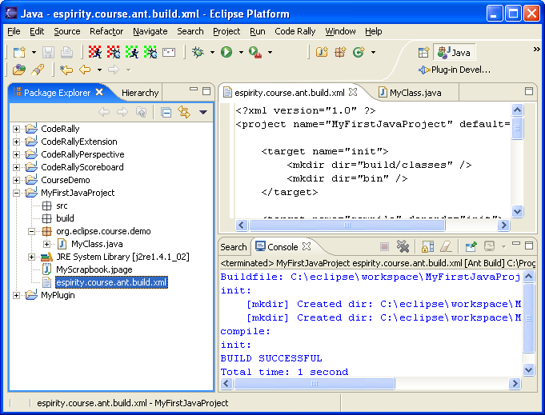
Run the Build File
Click Run to run Ant buildfile on the selected targets
Console displays execution results

Slide 34
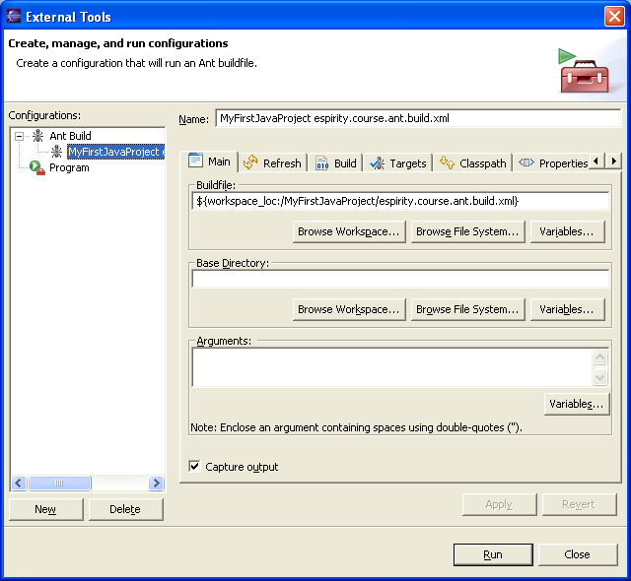
Ant Configuration
Previous steps create a persisted launch configuration
The configuration will appear in the launch history under Run → External Tools
Configuration is available in the launch configuration dialog which is opened by clicking Run → External Tools → External Tools….

Slide 35
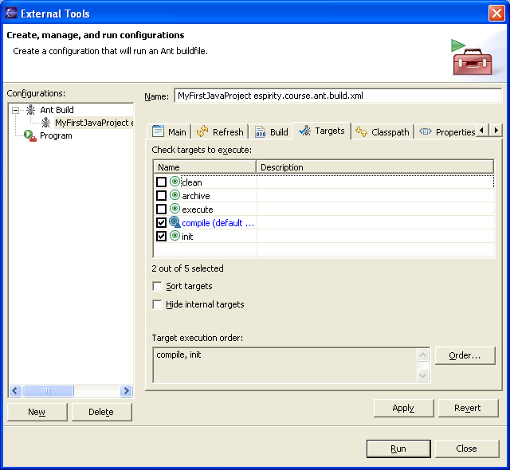
Updating Configuration
Update targets under the target tab in the configuration window
Run configuration again

Slide 36
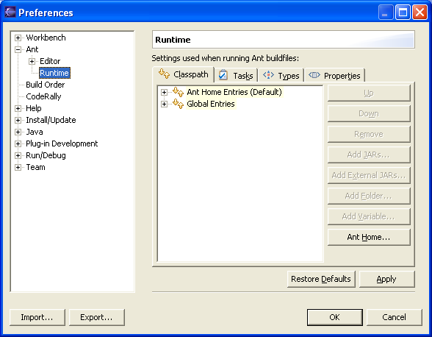
Ant Classpath…
Used to add extra libraries to the classpath
  When using optional or custom tasks
  Classpath can be modified globally or per launch configuration
To modify the Ant classpath globally:
  Click Window → Preferences
  Expand Ant and select Runtime
  If you are not on it already, click the Classpath tab

Slide 37
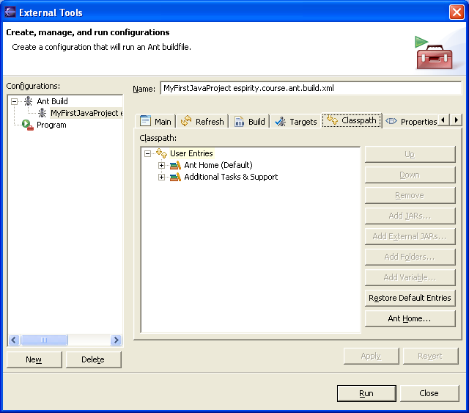
Modifying Ant Classpath…
To modify the Ant classpath for a launch configuration:
  Click Run -> External Tools -> External Tools...
  Select the Ant configuration whose classpath you wish to modify
  Select the Classpath tab
  Uncheck the option to use the global classpath as specified in the preferences

Slide 38
…Modifying Ant Classpath
To add a JAR file to the classpath:
  Click Add Jar
  Select the JAR file
To add a folder to the classpath:
  Click Add Folder
  Select the folder
To remove an item from the classpath:
  Select the item
  Click Remove
To restore the classpath to the default:
  Click Restore Defaults

Slide 39
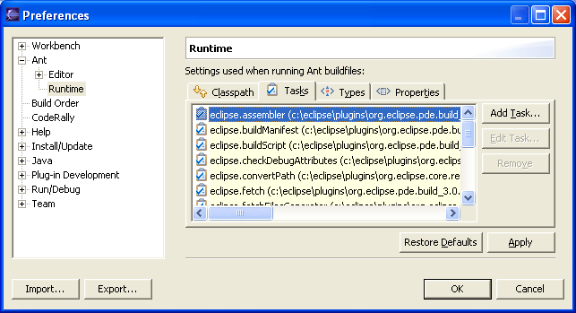
Adding New Tasks and Types
Click Window -> Preferences
  Expand Ant and select Runtime
  Click the Tasks tab or the Types tab
  Click Add Task or Add Type
  Provide a name and class for the task or type
  Select the library where the task or type is declared
    If the library is not present on the list, you must add it to the Ant classpath first

Slide 40
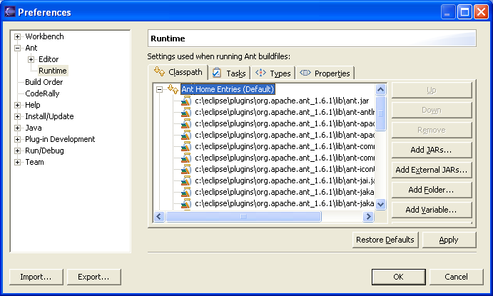
Using a Different Version of Ant
Ant looks for the necessary classes on the Ant classpath
  Classpath identifies the plug-ins contributing new tasks, types or libraries
Ant requires JAR files:
  ant.jar
  optional.jar
Remove these JARs and add the new ones
To restore the Ant classpath to its original state, click Restore Defaults button on the properties page
Notes:
Note that explicitly adding the Xerces JARs to the runtime Ant classpath is no longer required and will cause problems
All future Ant builds will use the updated version.
The Xerces classes are loaded from the org.apache.xerces plug-in provided with Eclipse. For most Ant distributions, the Xerces JARs cannot even be in the same physical location as the ant.jar and optional.jar. This results from the Ant JARs containing manifest files which contain classpath entries pointing to the Xerces JARs.

Slide 41
Module Summary
In this module we have:
  Learned what Ant is and what it is used for
  Described Ant build file and how to execute it
  Described Ant’s integration with Eclipse

Slide 42

Labs Slide!
Lab: Using Ant

